Slide 1
Was CIMI too early?
Dublin Core and Museum Information: metadata as cultural heritage data
Liddy Nevile Sophie Lissonnet
La Trobe University James Cook University Australia Australia

Slide 2
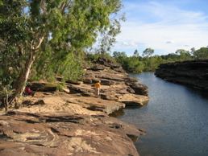
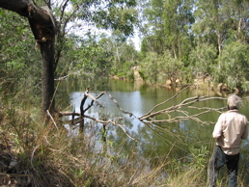
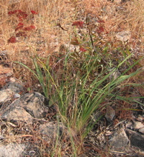

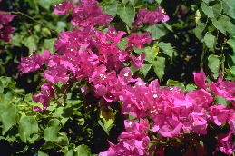

Slide 3
Was CIMI too early?
Dublin Core and Museum Information: metadata as cultural heritage data
Liddy Nevile Sophie Lissonnet
La Trobe University James Cook University Australia Australia

Slide 4
Summary
CIMI reported in 2000, on the use of DC metadata in the museum context and proposed adding a broader set of elements.
We re-examined that decision in 2004 and reached a different conclusion.
We used metadata application profiles, schema cross-walks and rich descriptions (data) and Semantic Web technologies.

Slide 5
Introduction
The CIMI Consortium (Consortium for the Computer Interchange of Museum Information) investigated
the original simple Dublin Core Metadata Element Set
in two phases between 1998 and 2000.

Slide 6
CIMI Phase 2 (2000) concluded
DCMES too focused on description of digital resources to cater sufficiently for museums' need to describe physical objects.
CIMI doubted the ability of DC, of bibliographic tradition, to adapt to the specific needs of the museum community.

Slide 7
CIMI Phase 2 (2000) concluded
Museums need contextual information about people, places and events and the relationships between them and other objects, so
CIMI recommended using DCMES for basic inter-operability,
“in conjunction with a domain specific
model that can be used by museums
sharing rich, complex records”.

Slide 8
We say, “DCMES is richer now …”
CIMI relied on the dumb-down principle for inter-operability. This rule is now largely replaced by cross-walks and application profiles.
DC metadata can be represented now using Resource Description Framework (RDF).

Slide 9
The Quinkan Matchbox Project
An Australian experiment using qualified Dublin Core metadata tested in a virtual museum context.
Techniques associated with using an application profile, a facility for cross-walking between metadata sets, RDF and recent developments in practice, were all assumed.

Slide 10
The Quinkan Matchbox Project
to support a tiny Indigenous community to manage and preserve its cultural knowledge
to contribute to ‘virtual’ repatriation of cultural materials and intellectual property dispersed nationally and internationally
to focus on culture that relates to at least 100,000 cave paintings but is more than a collection of physical artefacts.

Slide 11
The Quinkan Matchbox Project
inspired by the Digital Collective model which encourages organisations and individuals to contribute physical and digital materials and descriptions to a locally managed system
A central metadata application profile (MAP) for the Quinkan Matchbox assists in the local description and classification of distributed resources.

Slide 12
The Quinkan MAP
supports the import, integration, and export, of metadata records produced by a variety of intellectual communities for a variety of purposes with low levels of loss
is Dublin Core compliant
reflects the Quinkan community’s view of cultural heritage, as best it can be understood, with local usage elements, element refinements and vocabularies.

Slide 13
Quinkan country and culture
‘Quinkan Country’ is at the north-eastern corner of Australia.
Its centre is the small township of Laura with 60 or so residents (mostly Indigenous).
The estimated 100,000 ancient paintings and engravings are scattered throughout the lush savanna and high escarpments of Quinkan country.

Slide 14
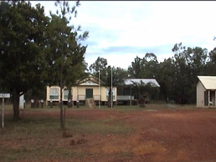
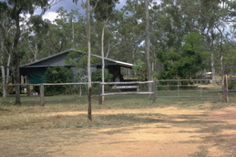
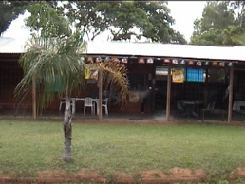
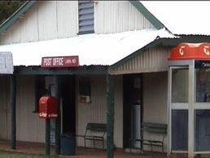

Slide 15
Quinkan country and culture
European settlement and gold rushes of the 1870s caused enormous disruption to traditional life.
The few remaining local Indigenous families represent different language groups and include descendants of the original inhabitants.

Slide 16
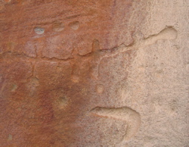
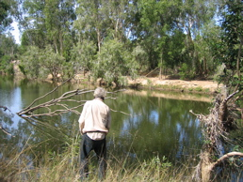
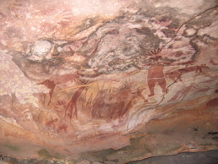
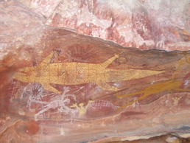
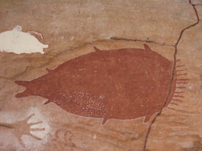
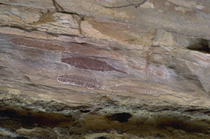
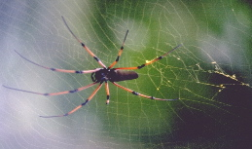
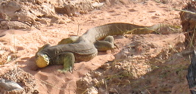

Slide 17
The Quinkan MAP
data is specialised according to discipline of research reported.
no simple way to merge it without intolerable loss of information of interest in cultural interpretation.
data is not always compatible: there is no established taxonomy because there is no single unifying perspective.

Slide 18
Issues
Some of the things we had to think about …..

Slide 19
Role information
archaeological charts are recorded by project teams, sites are surveyed by a variety of people and objects may have a collector and a donor whose roles and identities represent essential contextual and identifying information.
The problem for DC is that roles describe the person, not the resource.

Slide 20
Role information
But libraries and museums consider them relevant to the description of the resource.
The new DC Library Application Profile supports the use of role values as semantic refinements for Creator, Contributor and possibly Publisher .
The Library Application Profile has established a model that could be used for museums.

Slide 21
Biographical information
The DCMI Agents Working Group’s emphasised the agents in a business-like setting. Indigenous cultural resources agents may be known only by a nickname or by a specific style.
Museums’ emphasis is more on related dates and places, affiliation to language, ethnic or cultural groups, life roles and other biographical details.

Slide 22
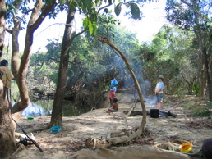
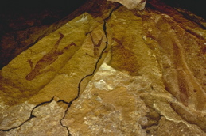
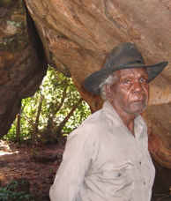
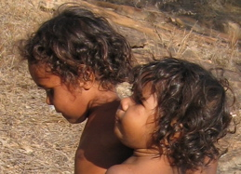

Slide 23
Biographical information
biographical information is less about the resource and more about the person
The J. Paul Getty Trust has authority files for more than 255,000 artists, with biographical and bibliographic information. Authorities are separated from records, but linked to them.
There is no mechanism to do this in the DCMES.

Slide 24
Type
museums are very interested in types
DCMI Type vocabulary classifies people, places and organisations as ‘physical objects’.
CIMI also proposed the addition of “party” and ”place”
The Quinkan MAP includes extra values to differentiate between records about ‘real’ places or objects and records about images of these places.

Slide 25
Type
Indigenous authors explaining ‘country’ see no dichotomy between natural and cultural for Indigenous people, as in the Western worldview. The common museum value-pair is not in the draft Quinkan MAP.
The CIMI perceived shortcomings of DCMES can now be adjusted easily with application profiles, as was done in the Quinkan MAP.

Slide 26
Localisation of metadata
Indigenous knowledge is embedded in communities and unique to a culture, location or society. Tradition is alive and depends on its ability to evolve and adjust.
Metadata must reflect current local views and be ‘flexible’ to discourage ‘enduring representations’ for public consumption, or constraining cultural interpretation, especially in a digital collective model.

Slide 27
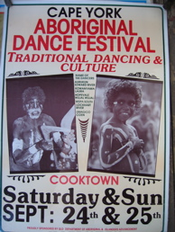
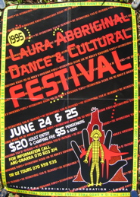
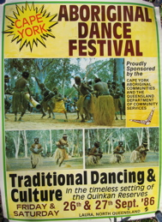
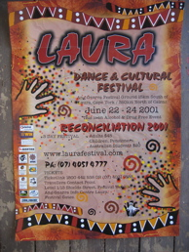
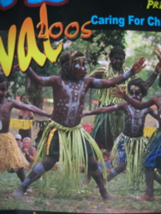

Slide 28
Localisation of metadata
The early, simple DC element set offered localisation and maintained inter-operability using the dumb-down model.
Now, qualified Dublin Core provides for details and local specificities and these can be maintained, particularly using suitable Resource Description Framework encodings.

Slide 29
Date and Coverage
Spatial and temporal coverage present a specific challenge in the museum world.
Precise dating is difficult and museums record the degree of accuracy of dates.
Early use of DCMES focused on interoperability being achieved by the use of limited vocabularies that are not of much value to museums.

Slide 30
Date and Coverage
Australian archaeological periods are named differently from European periods and have their own chronology and vernacular.
Many Indigenous people divide the year into five seasons that can be mapped to the months of the ‘European’ calendar.
The necessary date details can fit within the DC metadata elements, as in the Quinkan MAP, using qualified DCMES.

Slide 31
Language
ISO 639-2 languages, recommended by DCMES, do not contain any Australian Indigenous languages .
DCMES is still working on multi-linguality techniques.

Slide 32
Language
In the Australian Institute Aboriginal and Torres Straits Islander Studies’ catalogue, the preferred term for a given language name is linked to records containing spelling and naming variations.
The files relevant to the languages and cultural groups of the Quinkan region are proprietary so special searching aids, like maps or lists, will be needed for users.

Slide 33
Subject and Keywords
Global tools like the LCSH were developed for particular communities and reflect their values.
The local Australian and Torres Straits Islander Thesaurus is a combination of LCSH, local refinements, and rules for further refinement.

Slide 34
General conclusions
Qualified Dublin Core, application profiles, common use of XML and RDF, have all expanded the potential of the DCMES.
Recently the adoption of an abstract model has clarified the DCMES architecture and so helped clarify its use.

Slide 35
Metadata as data
In museums, metadata is not just for discovery.
For discovery, many museums argue for a simple ‘who, what, where, when and how’ taxonomy. Other Indigenous culture projects avoid cataloguing and let the culture speak out from a Website they create with Indigenous input.

Slide 36
Metadata as data
The Quinkan MAP follows mainstream museums: the “when, who, where” set, according to the immediate purpose for which the metadata is used is achieved by the choice of facets.
The provision of multiple entry points enables a variety of combinations ranging from a simple set of facets for discovery to a complex set for researchers.

Slide 37
Metadata as data
The combination (harvesting) of information sources from external sources, means metadata is often data at its origin.
E.g., the EPA has detailed records of painting sites, where it has been collected as the primary work of a ranger.
Metadata records, can be exploited to provide many voices to help interpret cultural heritage.

Slide 38
Metadata as data
Annotations of metadata records are now common in the museum world.
One incentive is multiple languages but when the collection relates to a culture with no written tradition, cultural experts can annotate records ‘verbally’, for example.

Slide 39
Other developments of interest
Where Google is inadequate, metadata provides human judgments to help solve the discovery problem.
Ontologies (dynamic) extend the value of rich metadata. The growth of the Semantic Web is increasing the range and style of museum vocabularies.

Slide 40
Other developments of interest
Aboriginal languages focus on the interconnected nature of people, places, objects and concepts. Their descriptions are not supported using rigid, uni-dimensional organisational principles.
We now have a choice of style – taxonomy, facets, rich descriptions, … to support a multiplicity of points of view to describe, question and interpret culture.

Slide 41
Other developments of interest
With metadata as data, we have scope to provide different views by inviting annotation of records. Museums are very interested in this. Some use wikis. We use RDF annotations and then FOAF to allow viewers to choose whose views to access.

Slide 42
Overall Conclusion
The Quinkan MAP takes advantage of the extensibility principle and extensible architecture of Dublin Core to include both resource- specific and localised extensions.
With its focus still on resource discovery, Dublin Core does not yet cover the vast range of functions metadata can enable.
DCMES is doing well but there is still more to be done!!

